Slide 1
Rvalues and lvalues in C++07 (recap)
First, I’ll define lvalue and rvalue in a simplified form. In the following, these concepts will be expanded in the future.
Definition: lvalue (locator value) is an object that occupies an identifiable location in memory (for example, every named object).
Definition: rvalue is defined by exception, saying that any expression is either an lvalue or an rvalue.
Thus, the definition of an lvalue implies that an rvalue is an expression that does not represent an object that occupies an identifiable memory location.

Slide 2
Temporary objects
Definition: temporary object is an object without name.
How to create: just call the constructor without naming the resulting object.
Examples:
std::vector<int> a = std::vector<int>(1000);
some_function(3, 4.0, std::vector<int>(10), std::string(“hello”))
some_class function_get_temp () { return some_class(); }
Property: temp object is always an rvalue.

Slide 3
Troubles of C++07
1) Variable initialization:
Int x = 5
Only one operation, because we’re working with built-in primitive types.
char y = ’s’
bool z = true
Two operations: constructor call for creating the temp vector with 5 elements and copy constructor call, because we’re working with the class type.
std::vector<int> vec = std::vector<int>(5);
Solution:
std::vector<int> vec(5);
Only one operation, exlicit call of the constructor from one int.

Slide 4
Troubles of C++07
2) Passing a temp object as a const argument:
void f (const std::vector<int> v) { … }
int main () {
f(std::vector<int>(100));
}
Two operations: constructor call for creating the temp vector with 100 elements and copy constructor call for initializing the element to pass to the function.
Solution:
Vector is getting received by the const reference, so in this case it’s getting bound to the temp object, so we don’t need to call the copy constructor.
void f (const std::vector<int>& v) { … }

Slide 5
Troubles of C++07
3) Passing a temp object as a non-const argument:
void f (std::vector<int> v) { … }
int main () {
f(std::vector<int>(100));
}
Two operations: constructor call for creating the temp vector with 100 elements and copy constructor call for initializing the element to pass to the function.
Solution:
There is no solution for this problem in C++07. We can’t pass the temp object as a non-const argument without copying it.

Slide 6
Troubles of C++07
4) Swap:
template <typename T>
void swap (T& x, T& y) {
T temp = x;
x = y;
y = temp;
}
Three operations: one copy constructor call and two calls of operator=. If we provide 2 vectors to the swap function each of size 100,000, the whole function will make approximately 300,000 operations.
Solution:
There is no elegant solution for this problem in C++07.

Slide 7
Troubles of C++07
5) vector::push_back:
Two operations: constructor call that initializes temp object and copy constructor call for push_back method.
std::vector<std::vector<int>> v;
v.push_back(std::vector<int>(1000));
Solution:
There is no elegant solution for this problem in C++07.

Slide 8
Solving the troubles of C++07
General idea
Problem: It is not possible to create optimal assignment and construction algorithms for class objects that will work optimally with temporary objects.
Idea of solution: We can introduce some new kind of a reference into the language that can be bound specifically to temporary objects. Since temporary objects are rvalues, we will call such references rvalue references.
How it should work: An rvalue reference will indicate that the object bound to it should be treated as temporary. Since the original object is not to be used anywhere else, we can leave it in an invalid state. Thus, the rvalue reference allows us to steal content from the source object.

Slide 9
New type of references: rvalue references
type& – reference (lvalue reference)
const type& – const reference
type&& – rvalue reference
rvalue reference is denoted by the special symbol &&.
Attention: this symbol does not indicate a reference to a reference! Double ampersand is a new indivisible special character that denotes a new kind of reference called rvalue reference.
When lvalue refs can be bound only to an lvalue, rvalue refs can be bound only to rvalues.
Examples:
int val = 5; /// an lvalue
int& lref_const = 2; /// CE: lvalue reference can’t be bound to the rvalue
int&& rref_const = 3; /// OK: rvalue reference can be initialized with an rvalue
Int& lref_val = val; /// OK: lvalue refernce can be initialized with lvalues
int&& rref_val = val; /// CE: rvalue reference can’t be initialized with lvalues
Int& lref_lref = lref_val; /// OK: lvalue refernce can be initialized with lvalues (even references)
Int&& rref_lref = lref_val; /// CE: rvalue reference can’t be initialized with lvalues
Int& lref_rref = rref_const; /// OK: lvalue refernce can be initialized with lvalues
int&& rref_rref = rref_const; /// CE: rvalue reference can’t be initialized with lvalues

Slide 10
std::move(…)
Definition: std::move(…) is a function that defined in the <utility> header. It receives an object and returns an rvalue reference to it.
Consequence: the result of std::move(…) is always an rvalue-reference. So, when passed to some function, the initial object won’t get copied. Instead, it will be treated as a temporary one, so the contents will get stolen from it.
Note: std::move(…) doesn’t move anything. The function just allows to steal the contents from the initial object on constructing and assigning from it. I don’t really know why it is called like this… In my opinion, the best name for the function is rvalue_cast.
Example:
Here we provide the temporary object as an rvalue-reference, so the vector v has stolen the contents from the temporary value.
std::vector<std::vector<int>> v;
v.push_back(std::move(std::vector<int>(1000)));

Slide 11
Invalidation of the initial objects after std::move(…)
std::move(…) creates rvalue reference to the initial object. Rvalue reference allows to steal the contents of the initial object, so, when passed to constructor or operator=, the insides of the object will be taken and it’ll be invalidated.
Example:
template <typename T>
void swap (T& x, T& y) {
T temp = std::move(x);
x = std::move(y);
y = std::move(temp);
}
All operations were performed by stealing the contents of objects. This is optimal, because instead of byte-wise copying, we can simply move all the content at once to another object.

Slide 12
Move constructor of the class
Definition: Move constructor is a special type of constructor that works only with rvalues and steals the contents from the provided objects.
How to use: move constructor should be implemented inside the class by the programmer.
When it’s getting called: it’s getting called when an rvalue reference to the instance of the class is getting provided to a constructor of the same class. Compiler always calls the optimal move constructor when it’s possible instead of the non optimal copy constructor.
Example:
std::vector first(1000);
std::vector second(std::move(first));
Here the move constructor will be called for the object instead of the copy constructor.

Slide 13
Signature of the move constructor
struct cl {
cl (cl&& other) noexcept { … }
};
struct cl {
cl (const cl& other) { … }
};
VS
Move constructor receives an rvalue-reference (a reference to a temp object).
It’s highly recommended to mark the move constructor as noexcept and never throw exceptions from it.
Copy constructor receives a const lvalue-reference.
lvalue-reference is denoted by one ampersand. Copy constructor can be non-noexcept and can throw exceptions.

Slide 14
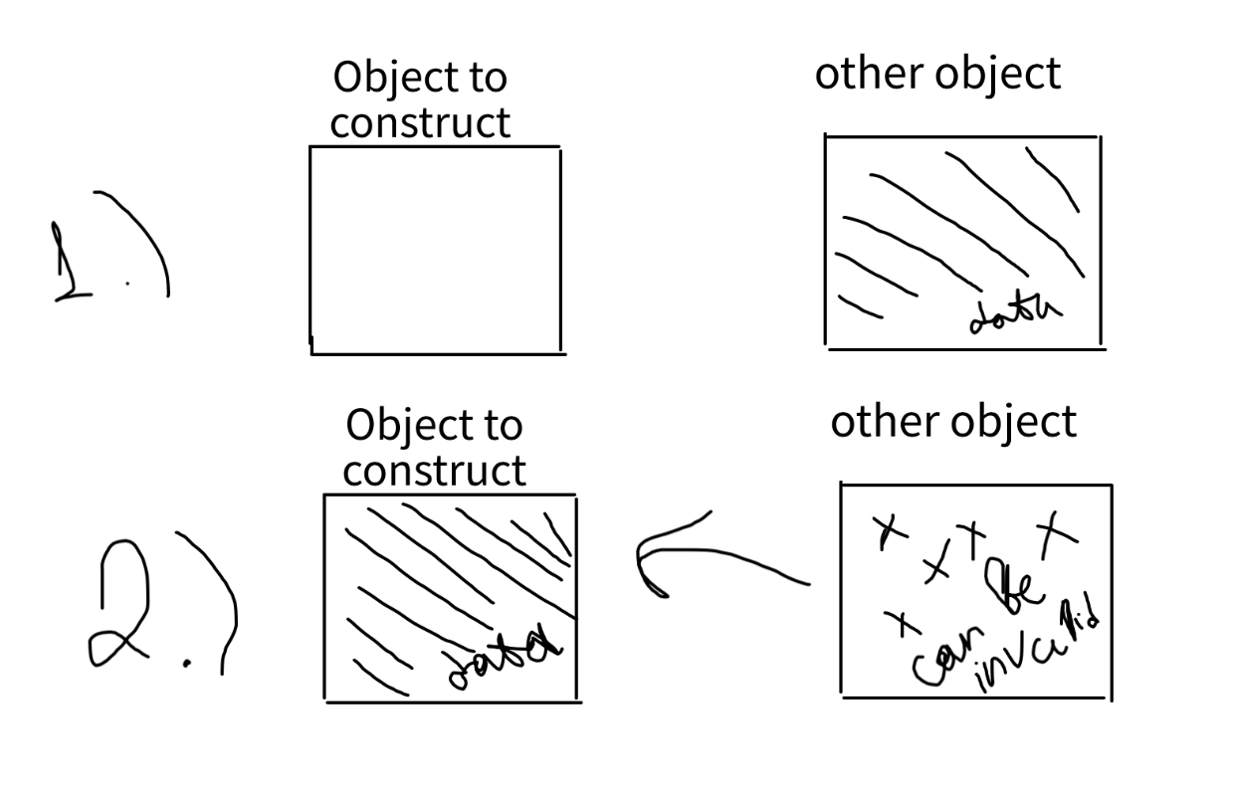
Implementing the move constructor
struct cl {
cl (cl&& other) noexcept { … }
};
Move constructor should steal the contents via the provided rvalue. We don’t care about the other object, so we can invalidate it in order to optimally move the data from it to the object that we want to construct.
Pic.1: stealing the contents from the object via rvalue reference.

Slide 15
Move assignment operator of the class
Definition: a special type of an assignment operator that works with rvalues and steals the contents from the provided objects.
How to use: move assignment operator should be implemented inside the class by the programmer.
When it’s getting called: it’s getting called when an rvalue reference to the instance of the class is getting provided to an operator= of the same class.
Example:
std::vector first(1000);
std::vector second(500);
second = std::move(first);
Here the move assignment operator will be called for the second object instead of the copy assignment operator.

Slide 16
Signature of the move assignment operator
struct cl {
cl& (cl&& other) operator= noexcept { … }
};
struct cl {
cl& operator= (const cl& other) operator = { … }
};
VS
Move assignment operator receives an rvalue-reference (a reference to a temp object). It returns a reference to the current object (lvalue reference, not rvalue reference!).
It’s highly recommended to mark the move assignment operator as noexcept and never throw exceptions from it.
Copy assignment operator receives a const reference.
lvalue-reference is denoted by one ampersand. Copy assignment operator can be non-noexcept and can throw exceptions.

Slide 17
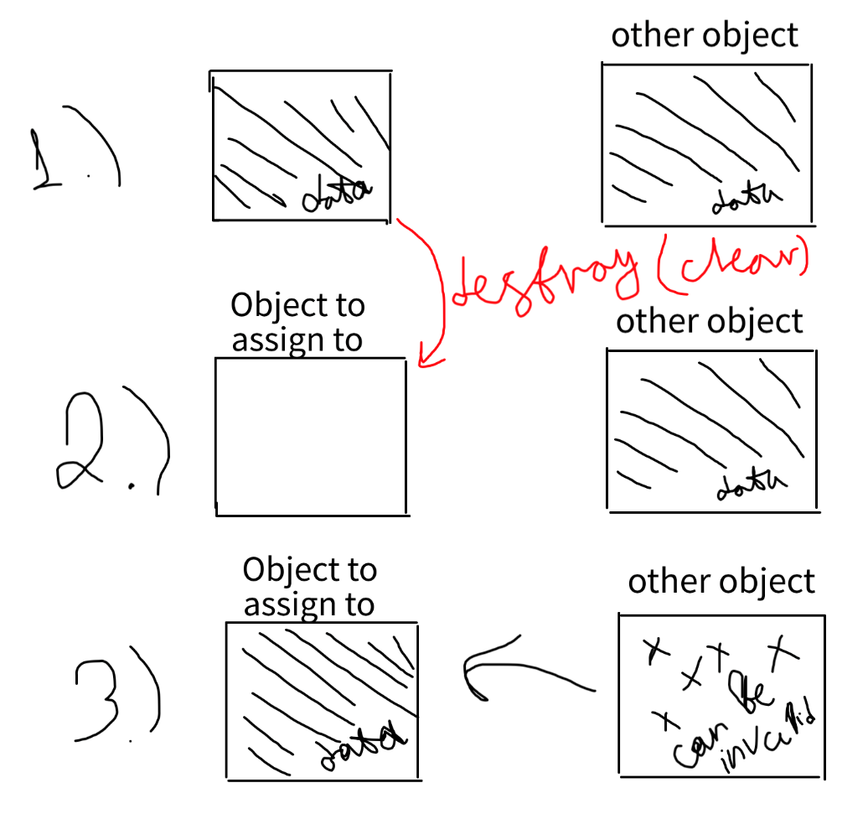
Implementing the move assignment operator
struct cl {
cl& (cl&& other) operator= noexcept { … }
};
Move assignment operator should steal the contents via the provided rvalue. We don’t care about the other object, so we can invalidate it in order to optimally move the data from it to the object that we want to assign to.
Pic.2: stealing the contents from the object via rvalue reference.

Slide 18
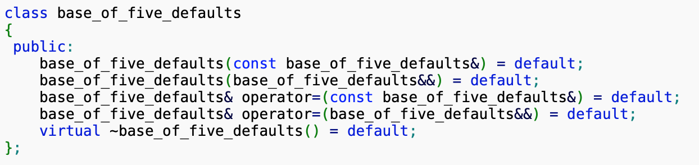
Default move constructor & move assignment operator
Compiler provides default definitions for move constructor and move assignment operator if and only if the user haven’t provided custom destructor, custom copy constructor, custom move constructor, custom copy assignment operator or custom move assignment operator.
Both move constructor and move assignment operator can be implicitly defaulted with an = default statement. Also, = delete statement is allowed too.
Pic.3: explicit default definitions

Slide 19
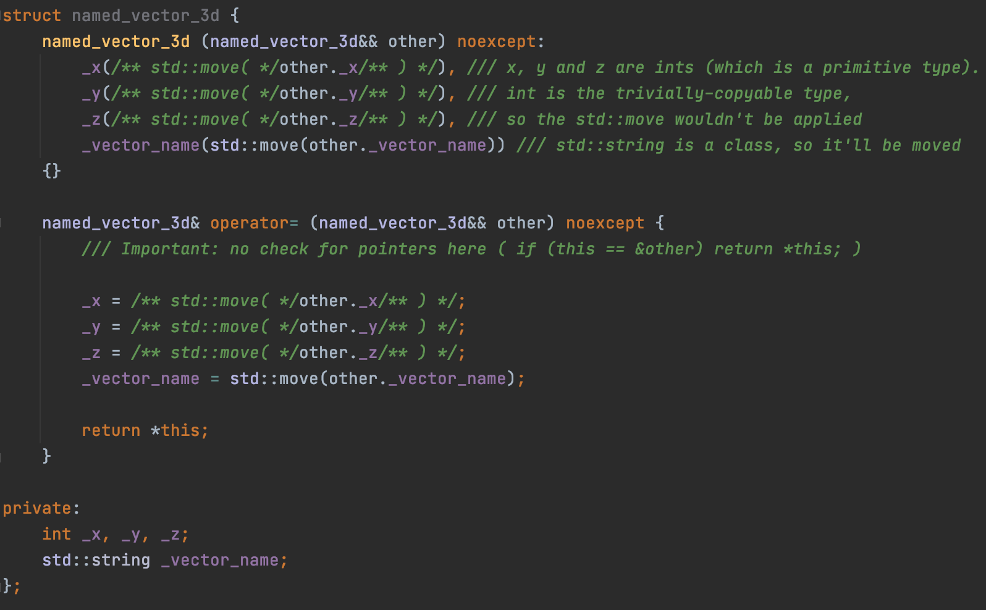
Default move constructor & move assignment operator
Pic.4: emulating default move constructor and default move assignment operator

Slide 20
The rule of three/five/zero
Rule of 3: If a class requires a user-defined destructor, a user-defined copy constructor, or a user-defined copy assignment operator, it almost certainly requires all three.
Rule of 5: Because the presence of a user-defined destructor, copy-constructor, or copy-assignment operator prevents implicit definition of the move constructor and the move assignment operator, any class for which move semantics are desirable, has to declare all five special member functions.
Rule of 0: Classes that have custom destructors, copy/move constructors or copy/move assignment operators should deal exclusively with ownership. Other classes should not have custom destructors, copy/move constructors or copy/move assignment operators.

Slide 21
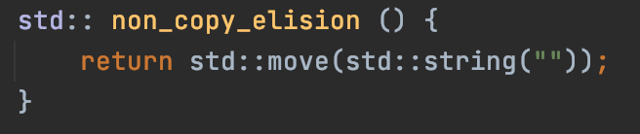
Copy elision
Copy / move elision is an optimization in which the compiler can remove some calls to the copy constructor and destructor.
When returning from a function, using std::move() can reduce performance by limiting the compiler in Copy elision optimization, because the absence of a constructor is faster than a move constructor.
Pic.5: Breaking copy elision
Here std::move(…) only slows down the code by adding an extra call to std::string (std::string&& other) and ~std::string().

Slide 22
RVO (Return Value Optimization)
Omits calling the copy constructor when an object is getting assigned to a temporary return value of a function.
Example:
std::vector<int> get_big_vec () { return std::vector<int>(1000); }
int main () {
std::vector<int> vec = get_big_vec();
}
C++07: Temp object will be constructed, then the returned and used as an lvalue for copy constructor.
C++11: No copy or move constructor calls. Pure magic.

Slide 23
NRVO (Named Return Value Optimization)
Same as an RVO, but works for named (non-temp) objects.
Example:
void get_big_vec () {
std::vector<int> vec(1000);
return vec;
}
int main () {
std::vector<int> vec = get_big_vec();
}
C++07: Object will be constructed, then the returned and used as an lvalue for copy constructor.
C++11: No copy or move constructor calls. Pure magic.

Slide 24
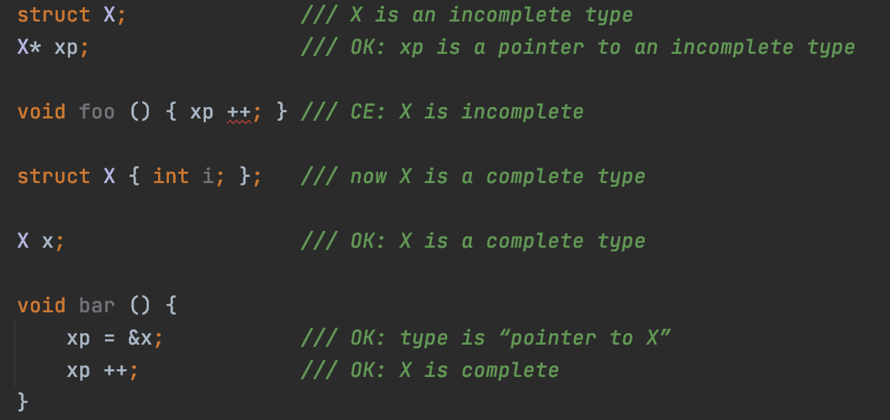
Complete and incomplete types
Definition: The following types are incomplete types:
the type void (possibly const-qualified);
incompletely-defined object types:
class type that has been declared (e.g. by forward declaration) but not defined;
array of an unknown bound (for example: int x[]);
array of elements of incomplete type;
enumeration type (i.e. enum) from the point of declaration until its underlying type is determined.
Definition: All other types are complete.
Pic.1: complete and incomplete types

Slide 25

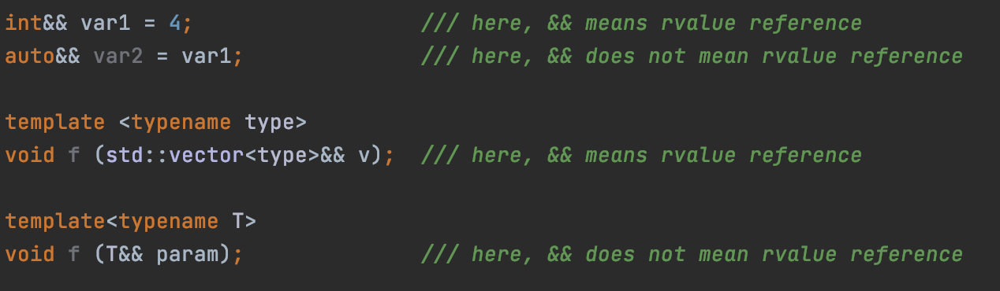
Universal references
Syntactically, rvalue references are declared like ”normal” references (now known as lvalue references), except you use two ampersands instead of one.
Lets look at the example: this function takes a parameter of type rvalue-reference-to-type.
Pic.2: rvalue reference ???
Given that rvalue references are declared using &&, it seems reasonable to assume that the presence of && in a type declaration always indicates an rvalue reference. But it doesn’t:
Pic.3: rvalue reference vs universal reference

Slide 26
Universal references
The && - symbol has a double meaning in C++. Sometimes it is treated as rvalue reference, sometimes as something else called universal reference. Let's learn how to determine when && stands for one thing and when it stands for another.
Definition: vt&& is treated as a universal reference when the vt type has no qualifiers and type deduction takes place and compiler deduces the vt type. In oppose, && won’t be treated as a universal reference if the vt type is fully specified. Otherwise, vt&& is treated as an rvalue reference.
Pic.4: universal reference
In the example above, the type type is getting deduced, because it’s a template parameter of the function f.

Slide 27
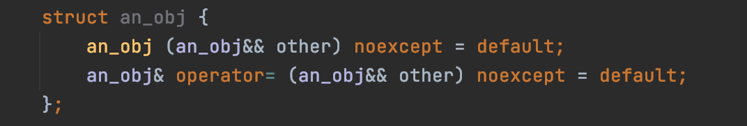

Universal references
What about the move constructor and move assignment operator?
Do we receive universal references there?
Pic.5: universal references???
The answer is no, because an_obj type is fully specified, it’s not getting deduced.
What about the case when the deduced type is a part of the type to which we apply && ?
Pic.6: universal references???
In this case, vec will not be a universal reference. && is applied to std::vector<type> but not to the type type which is getting deduced as a template parameter.

Slide 28
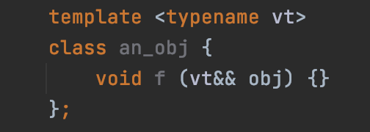
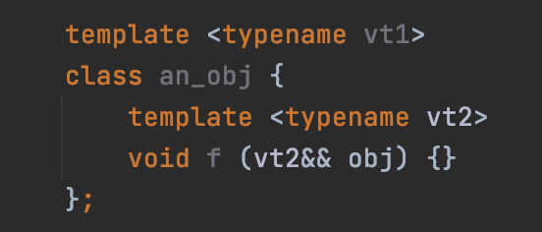
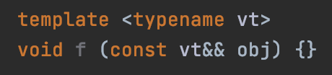
Universal references
Another examples:
Pic.9: universal references???
Pic.7: universal references???
Pic.8: universal references???
rvalue reference. The vt type is getting deduced for the class and not for the function f. vt is fully defined at the moment of definition of the method f, because it is getting bound to a complete an_obj<vt> type: an_obj<vt>::f().
universal reference. The type vt2 is getting deduced for the method f.
rvalue reference. Const keyword is a qualifier, qualifiers are prohibited for universal references.

Slide 29
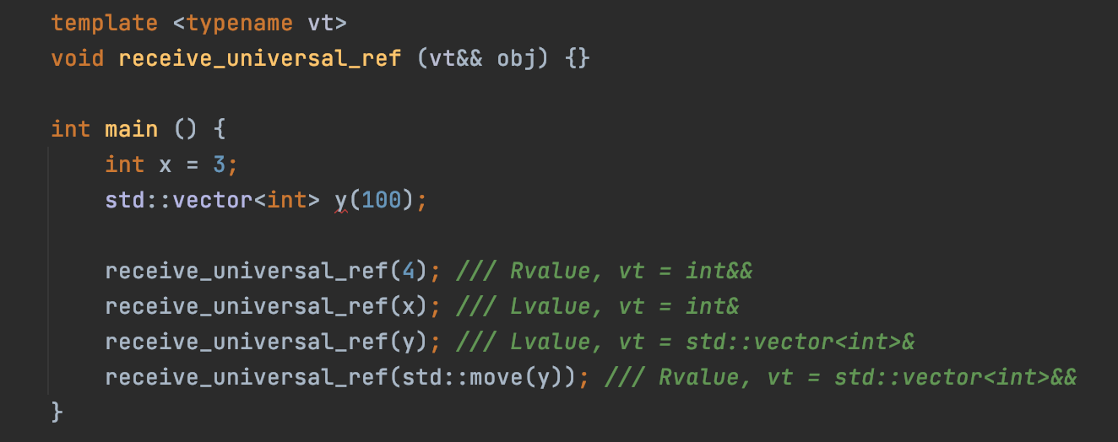
Universal references
Rvalue / lvalue reference
Binds rvalues / lvalues only
Indicates moving / copying of objects.
Universal reference — special type of reference that can bind every value.
Can bind lvalues, rvalues (const or non-const) thus everything.
Facilitate copying, or moving.
Syntactically type&& but semantically type&& or type&.
Note (Reference collapsing rule):
vt = int => vt&& = (int)&& = int&&
vt = int& => vt&& = (int&)&& = int&
vt = int&& => vt&& = (int&&)&& = int&&
Pic.10: rvalue ref vs universal ref

Slide 30
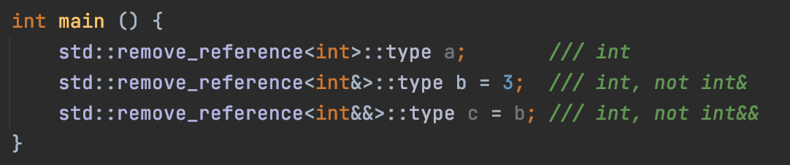
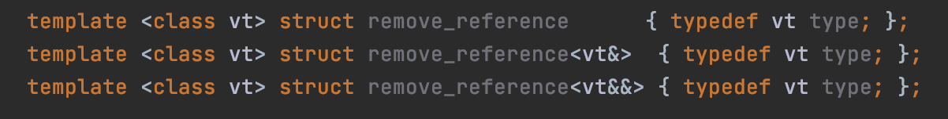
std::remove_reference
It’s a struct defined in the <utility> header.
If the type vt is a reference type, provides the member typedef type which is the type vt references. Otherwise type is vt.
Pic.11: examples of usage
The struct can be implemented easily using the idea of template specialization:
Pic.12: possible implementation

Slide 31
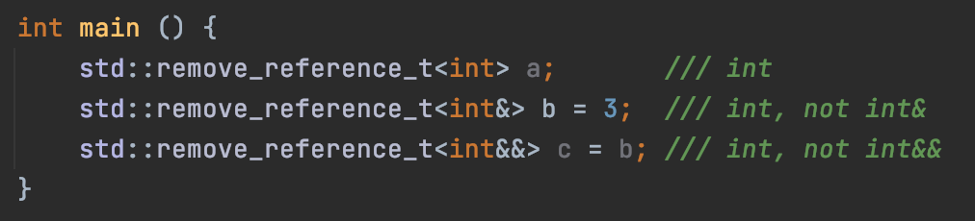
std::remove_reference
C++14 introduced a new typedef for simplicity: std::remove_reference_t<…>.
You don’t need to access the ::type member type anymore.
Pic.13: remove_reference_t, example of usage
Can be implemented easily with one simple typedef:
Pic.14: possible implementation

Slide 32
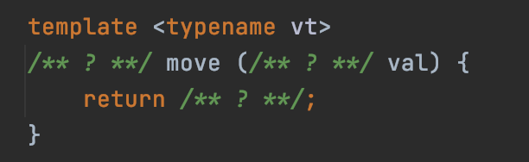
std::move implementation
Pic.15: implementation of the std::move, template

Slide 33
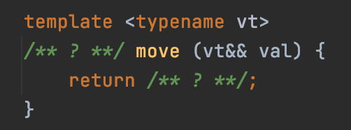
std::move implementation
Pic.16: implementation of the std::move, argument type
We should receive the object via the universal reference in order to make it possible to receive both lvalues and rvalues. For example when vt = int&, vt&& = (int&)&& = int& (due to the reference collapsing rule), therefore, the val is getting received by an lvalue as expected.

Slide 34
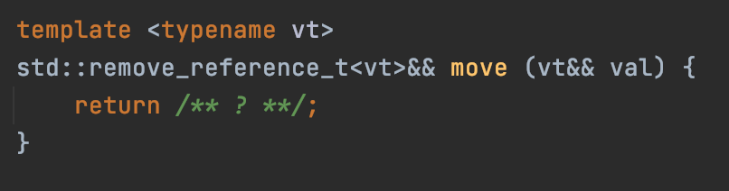
std::move implementation
Pic.17: implementation of the std::move, return type
We should receive the object via the universal reference in order to make it possible to receive both lvalues and rvalues. For example when vt = int&, vt&& = (int&)&& = int& (due to the reference collapsing rule), therefore, the val is getting received by an lvalue as expected.
vt typename can store reference in some cases. So we need to remove the reference from the vt type before appending double ampersand to it.

Slide 35
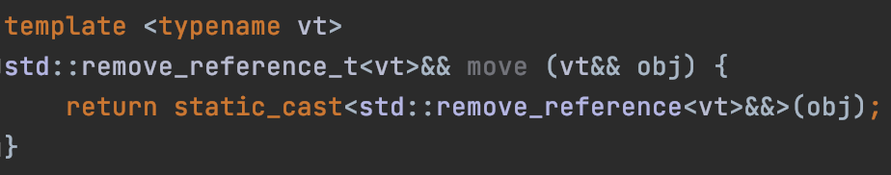
std::move implementation
Pic.18: full implementation of the std::move (C++14 and later)
We should receive the object via the universal reference in order to make it possible to receive both lvalues and rvalues. For example when vt = int&, vt&& = (int&)&& = int& (due to the reference collapsing rule), therefore, the val is getting received by an lvalue as expected.
vt typename can store reference in some cases. So we need to remove the reference from the vt type before appending double ampersand to it.
Std::move doesn’t move something to somewhere, it just casts the given object to an rvalue reference which then tells the compiler to treat the returned object as a temporary one. So, all that we need is to call the static_cast operator.

Slide 36
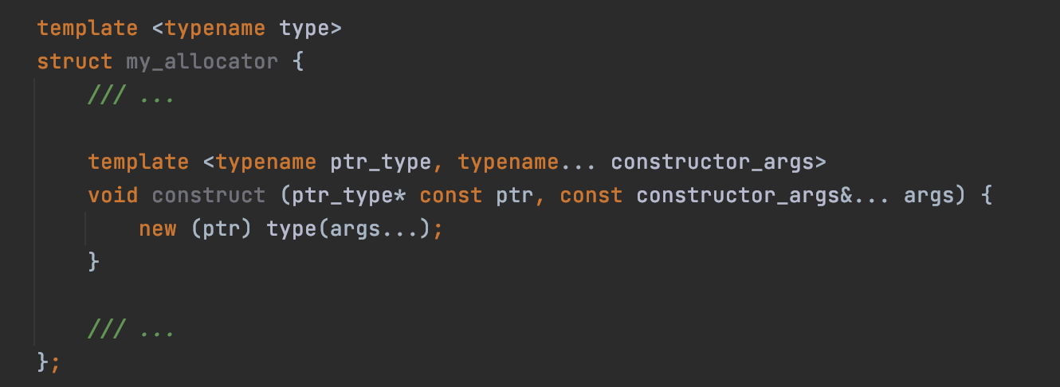
An unexpected recollection from the past…
Pic.19: method construct in allocators
Notice: the construct method is not compaitible with rvalue references for constructor arguments. This implementation of the construct method is not optimized for working with temporary objects. Lets try to fix it by replacing the const reference with a universal reference.

Slide 37
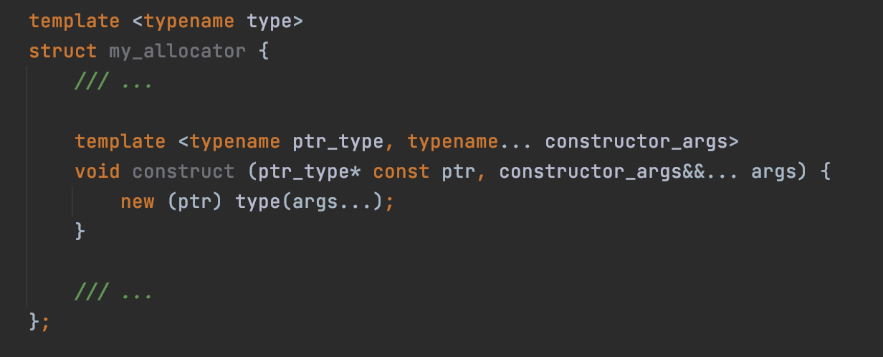
An unexpected recollection from the past…
Pic.20: method construct in allocators, first fix
Now we can provide both lvalues and rvalues to the construct method. But immediately after the construct method receives the args via the universal reference, they become lvalues, because now they are named entites (named => lvalues)! So they are getting provided to the operator placement new as lvalues (so, again, for temporary objects it’ll cause a copy)!

Slide 38
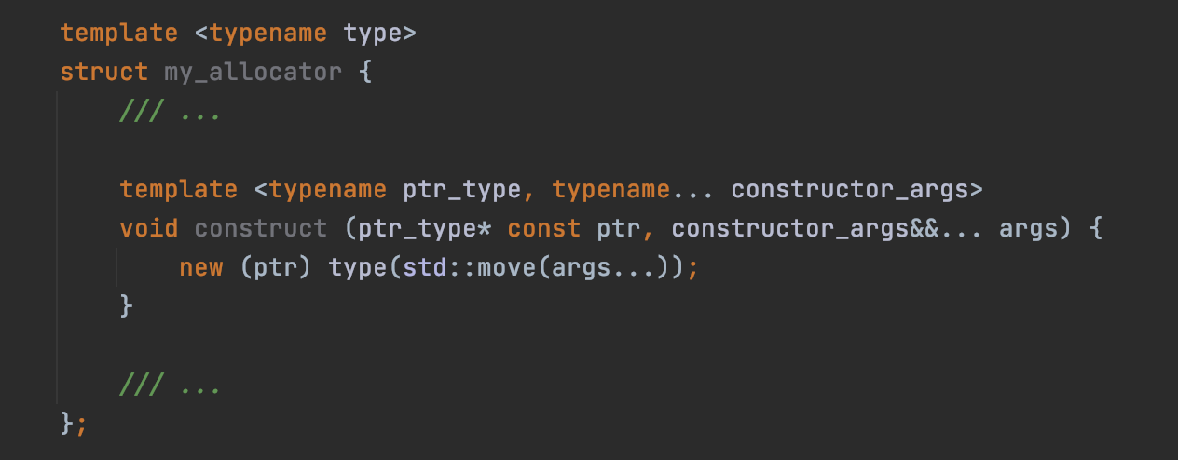
An unexpected recollection from the past…
Pic.21: method construct in allocators, second fix
We’ve used std::move, so initial args that were provided via rvalues are forwarded to the operator placement new as rvalues. But lvalues will become rvalues too, which is wrong, because the contents will be stolen from all of the initial objects, even from these that shouldn’t be invalidated.

Slide 39
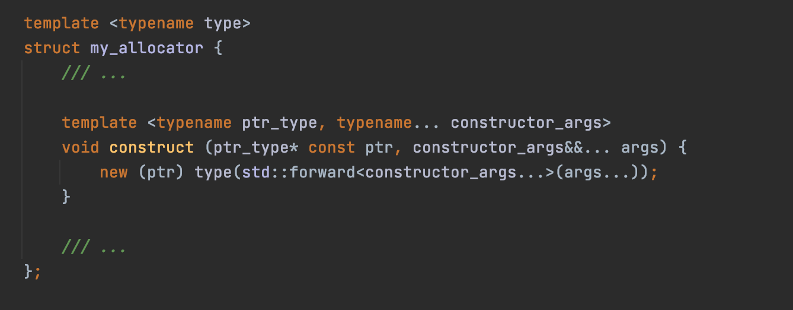
An unexpected recollection from the past…
So, now we want a way to somehow “restore” the initial categories of the provided values (lvalue or rvalue) and forward them to an operator placement new: rvalues should be forwarded as rvalues, lvalues should be forwarded as lvalues.
Pic.22: method construct in allocators, final fix

Slide 40
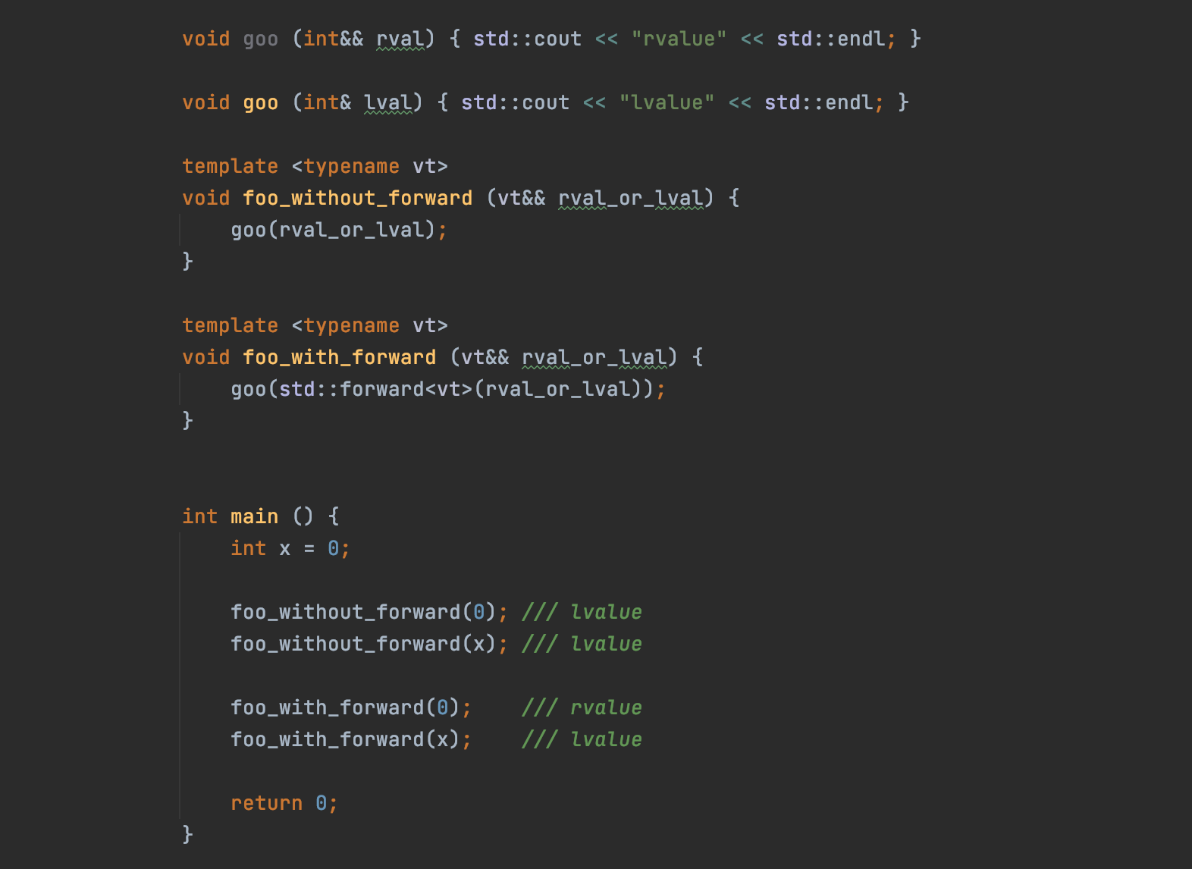
std::forward
Definition: when a variable obtained by a universal reference before is passed to the std::forward function, it returns a value of the same value category that this variable had before being passed.
Pic.23: example of usage of the std::forward function

Slide 41
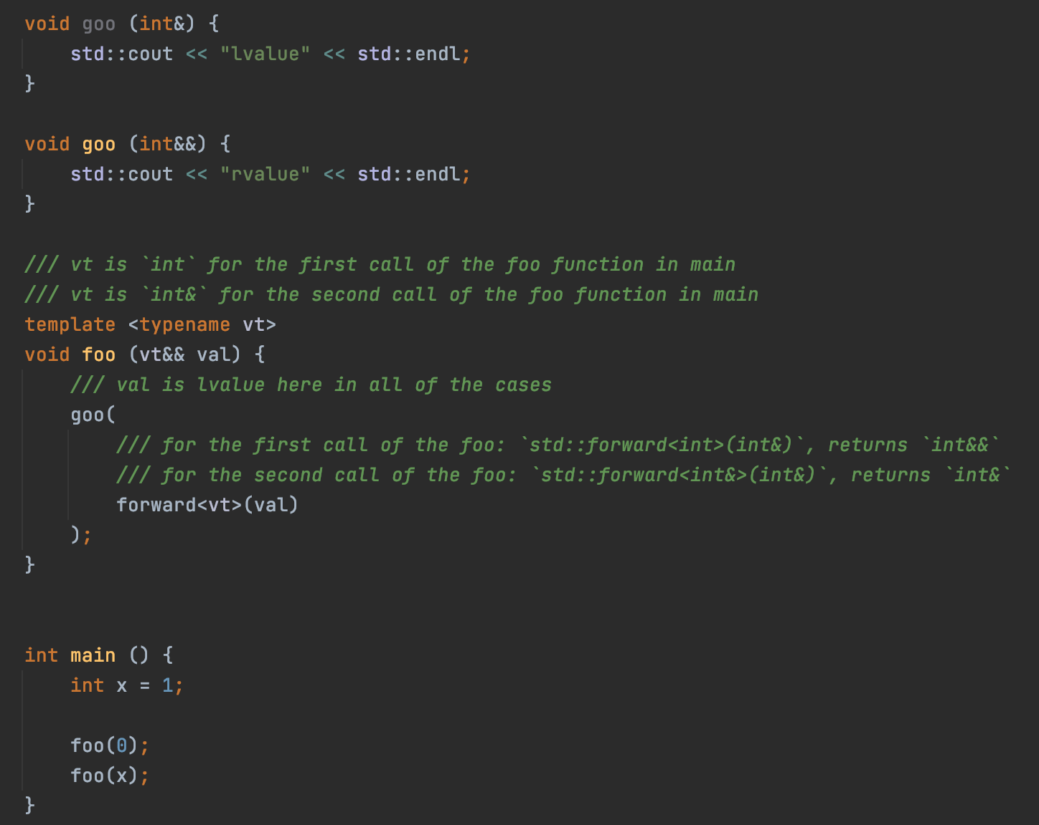
std::forward
But how does it work?
Pic.24: how std::forward works

Slide 42
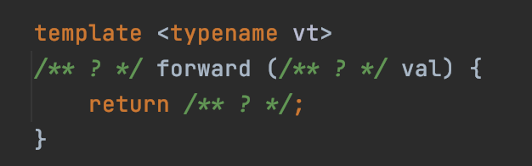
std::forward implementation
Pic.25: implementing the std::forward function

Slide 43
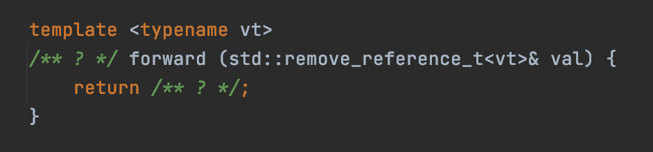
std::forward implementation
Pic.26: implementing the std::forward function: argument type fixed
In most of the cases, function forward are getting provided with an lvalue. So, we need to receive lvalue reference.

Slide 44
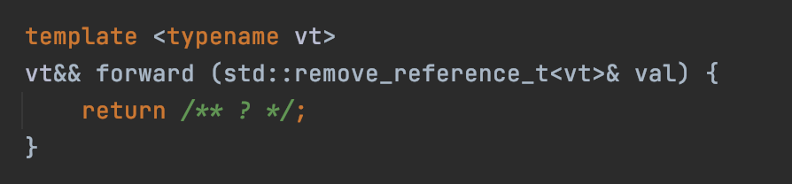
std::forward implementation
Pic.27: implementing the std::forward function: return type fixed
vt typename can be lvalue or rvalue reference in some cases and we want to return the value of the same category, so we use universal reference for return type because it supports both lvalues and rvalues.
vt typename can be lvalue or rvalue reference in some cases and we want to return the value of the same category, so we use universal reference for return type because it supports both lvalues and rvalues.

Slide 45
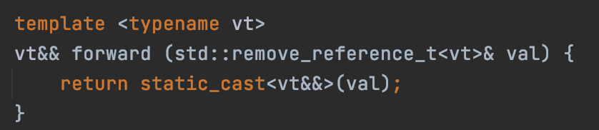
std::forward implementation
Pic.28: std::forward function implementation
vt typename can be lvalue or rvalue reference in some cases and we want to return the value of the same category, so we use universal reference for return type because it supports both lvalues and rvalues.
vt typename can be lvalue or rvalue reference in some cases and we want to return the value of the same category, so we use universal reference for return type because it supports both lvalues and rvalues.
As well as std::move, std::forward doesn’t do anything except the cast of the given object.

Slide 46
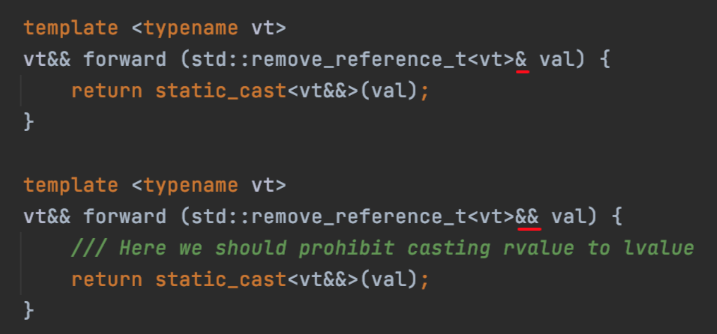
std::forward implementation
Pic.29: std::forward function implementation, two specializations.
First specialization is used to forward lvalues as lvalue or rvalue,
Second one should only be used for forwarding rvalues as rvalue.

Slide 47
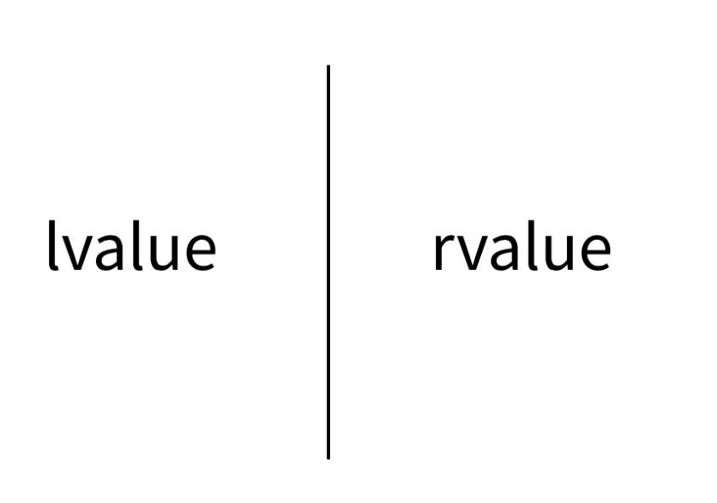
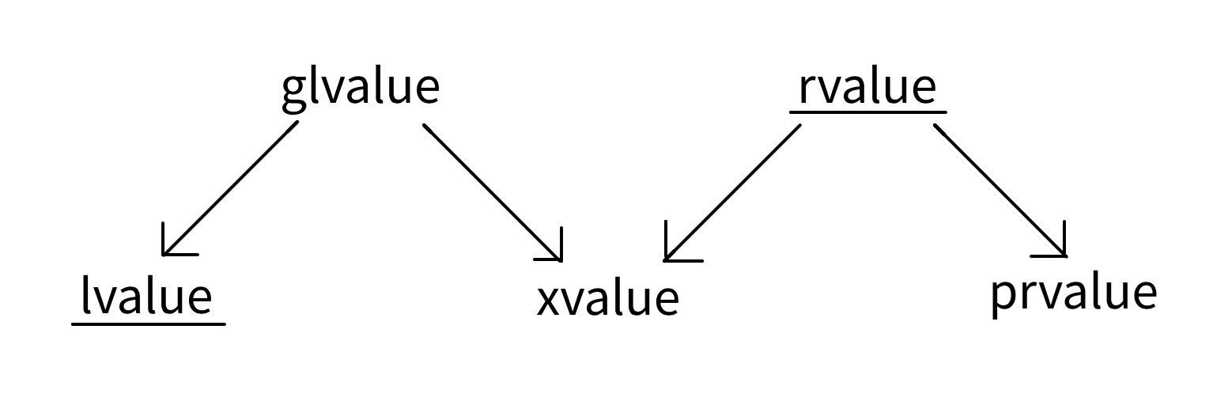
Value categories
Pic.30: value categories in C++07
Pic.31: value categories in C++11
In the C ++ language, the terminology of expression categories has evolved quite a lot, especially after the adoption of the C++11 Standard, which introduced the concepts of rvalue references and move semantics.

Slide 48
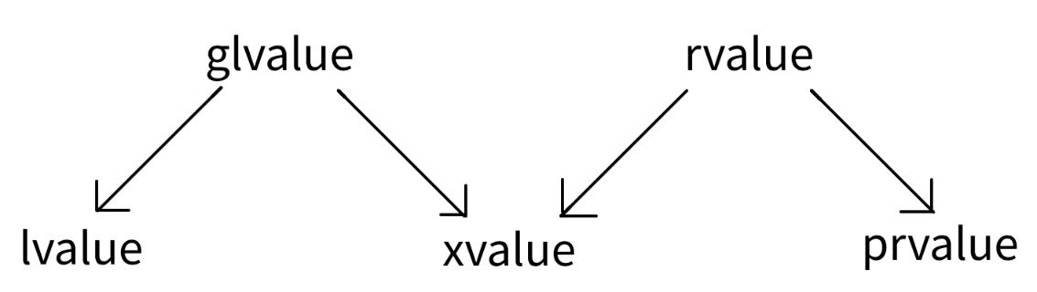

Value categories
Value names:
lvalue: locator value
prvalue: pure rvalue
xvalue: expiring value
rvalue
glvalue: generalized lvalue
Pic.32: value categories in C++11
Two properties of the values:
Identity – that is, some parameter by which you can understand whether two expressions refer to the same entity or not (for example, an address in memory).
The ability to move (contents can be moved from value) – the value supports move semantics.
Pic.33: two properties of values

Slide 49
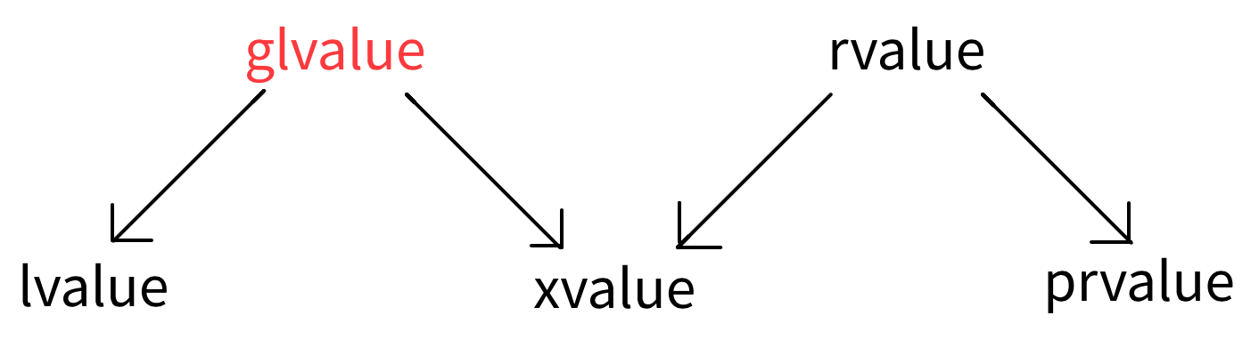
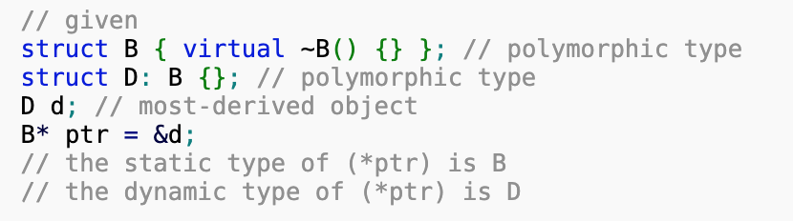
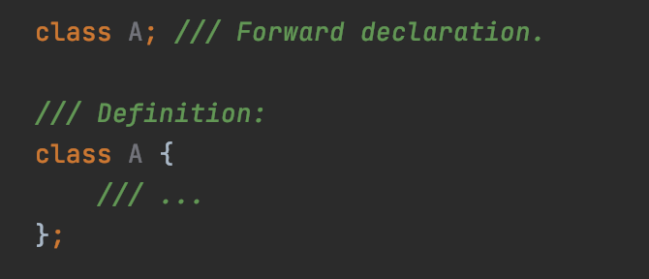
Value categories: glvalue
A glvalue expression is either lvalue or xvalue.
glvalue expressions have the following properties:
Can be implicitly converted to prvalue
Can be polymorphic
Cannot be of type void
Can be of incomplete type
Pic.34: value categories in C++11 (glvalue)
Pic.35: dynamic type demonstration
Pic.36: forward declaration vs definition

Slide 50
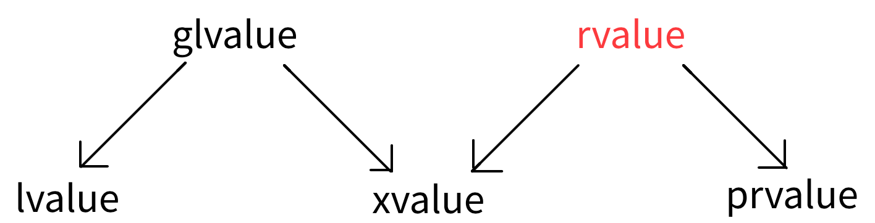
Value categories: rvalue
Pic.37: value categories in C++11 (rvalue)
An rvalue expression is either prvalue or xvalue.
rvalue expressions have the following properties:
Address of an rvalue cannot be taken by built-in address-of operator (operator &).
Can’t be on the left side of an assignment operator or compound assignment operators.
Can be used to initialize a constant lvalue reference or rvalue reference, while the lifetime of the object is extended to the lifetime of the reference (until the scope of the reference ends).
When used as a function argument and when two overloads of the function are available, one taking rvalue reference parameter and the other taking lvalue reference to const parameter, an rvalue binds to the rvalue reference overload.

Slide 51
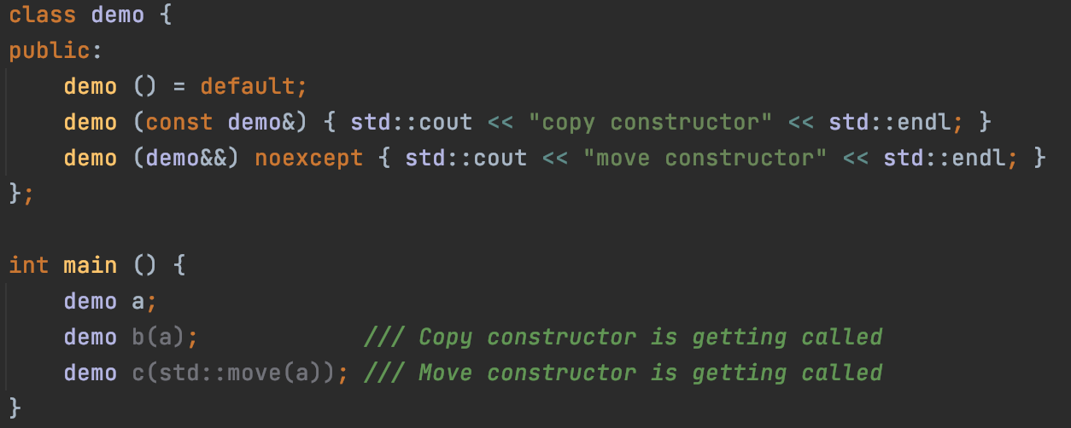
Value categories: rvalue (demo)
Pic.38: overload resolution for rvalues

Slide 52
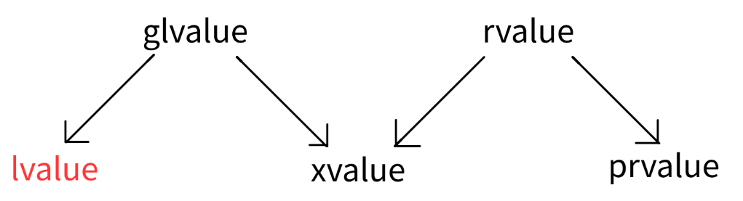
Value categories: lvalue
Pic.39: value categories in C++11 (lvalue)
lvalue expressions have the following properties:
All glvalue properties.
You can take the address (using the built-in address-of operator)
Modifiable lvalues ​​can appear on the left side of an assignment operator or compound assignment operator.
Can be used to initialize an lvalue reference (both constant and non-constant).

Slide 53
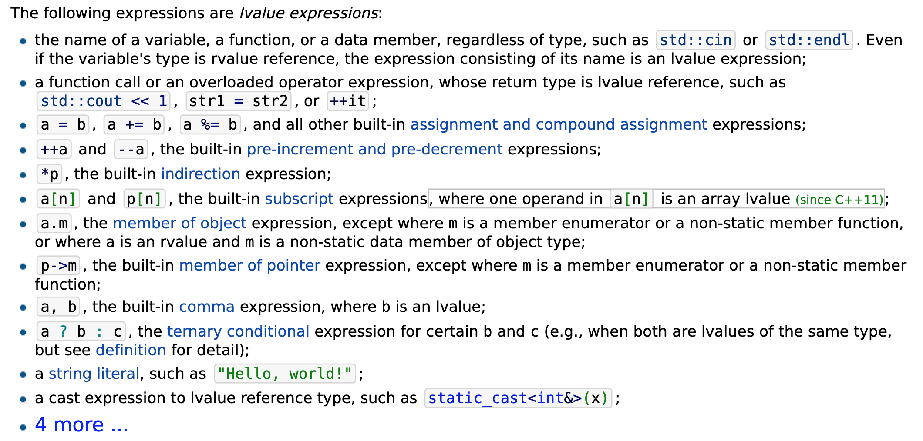
Value categories: lvalue (examples)
Pic.40: lvalue expressions (examples)

Slide 54
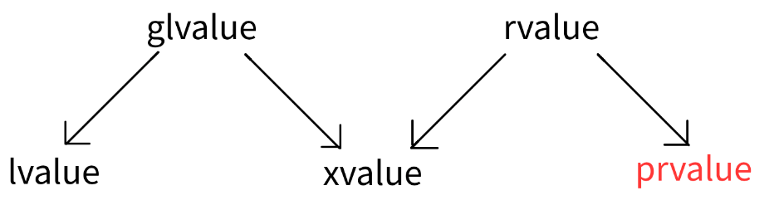
Value categories: prvalue
Pic.41: value categories in C++11 (prvalue)
prvalue expressions have the following properties:
All rvalue properties.
Cannot be polymorphic: the static and dynamic types of the expression are always the same.
Cannot be const-qualified.
Cannot be of an incomplete type (except for the void type).
Cannot be of an abstract type or an array of elements of an abstract type.

Slide 55
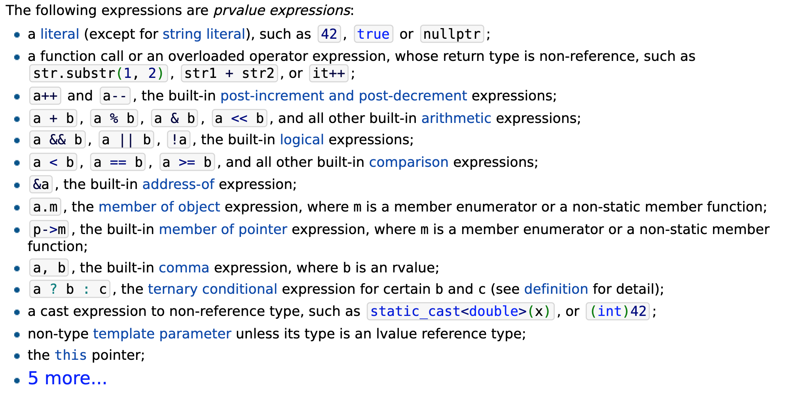
Value categories: prvalue (examples)
Pic.42: prvalue expressions (examples)

Slide 56
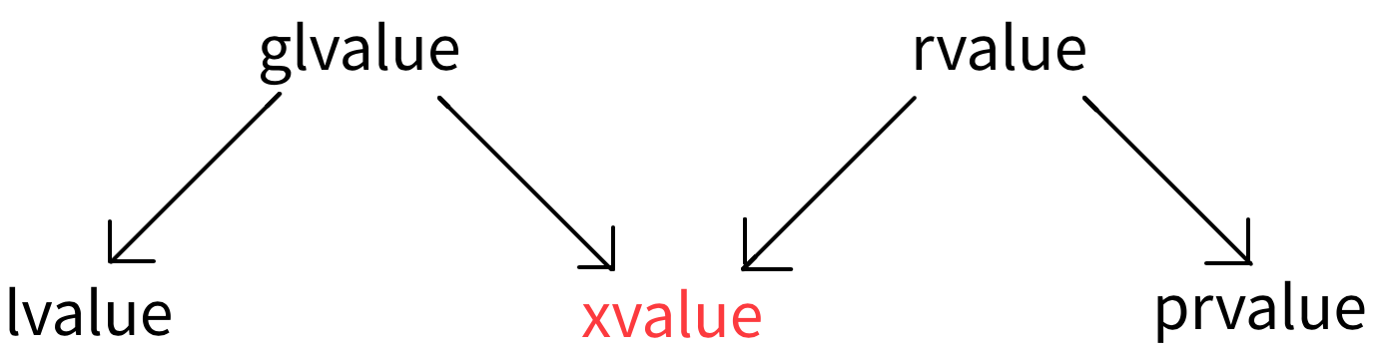
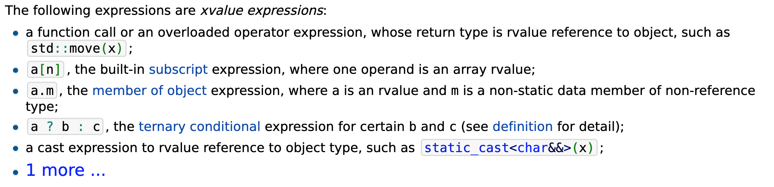
Value categories: xvalue
xvalue expressions have the following properties:
All rvalue properties (see above).
All glvalue properties (see above).
Pic.42: value categories in C++11 (xvalue)
Pic.43: xvalue expressions (examples)

Slide 57
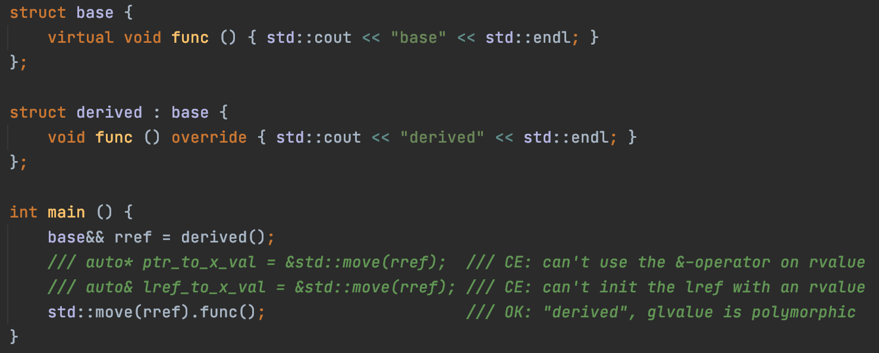
Value categories: xvalue (demo)
Pic.44: the dual nature of xvalues

Slide 58
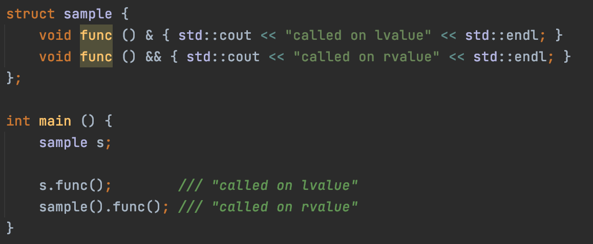
Reference qualifiers
Reference qualifiers:
&-qualifier makes the method callable only on lvalue objects.
&&-qualifier makes the method callable only on rvalue objects.
Pic.45: reference qualifiers

Slide 59
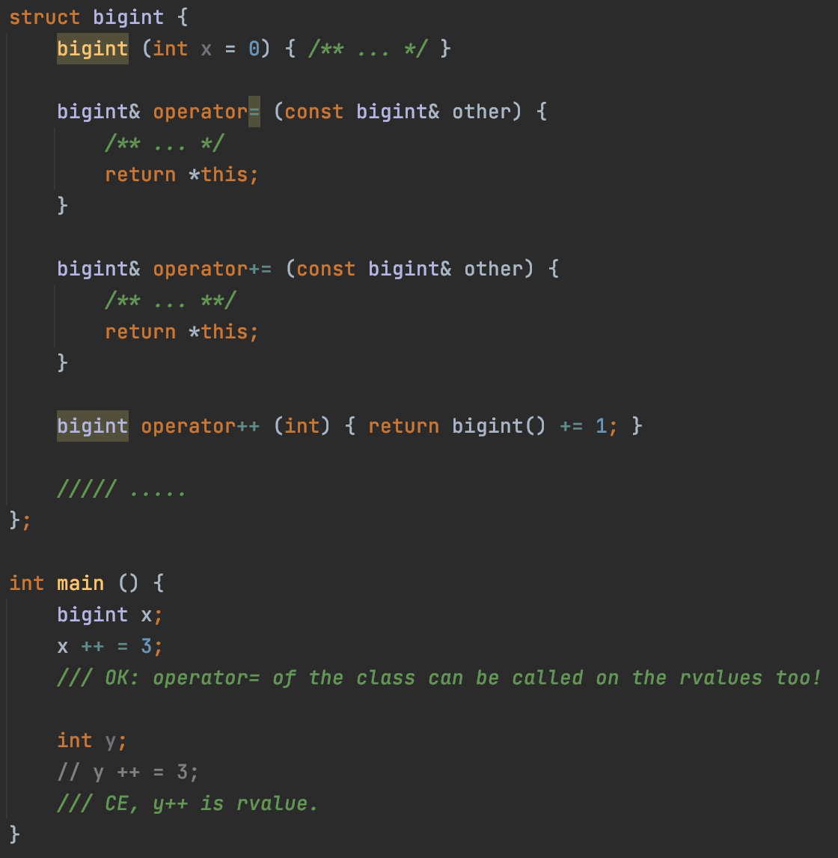
An unexpected recollection from the past 2…
We could change the prvalue returned from the operator++, which does not correspond to the usual behaviour of int.
We’ve solved this trouble by adding const to the return value of the operator++, but this solution looks like a dirty hack.
Pic.47: first solution of the trouble
Pic.46: a trouble with bigint’s operator++

Slide 60
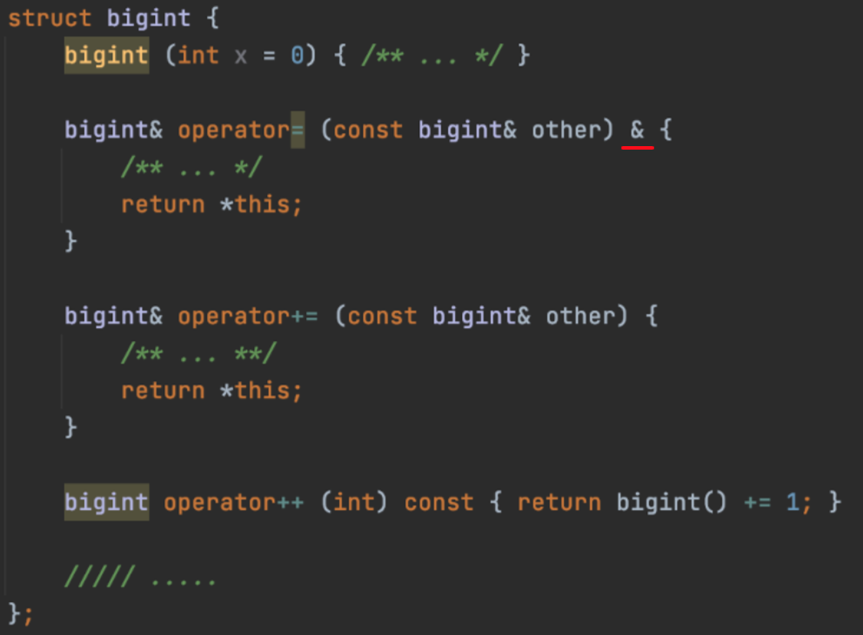
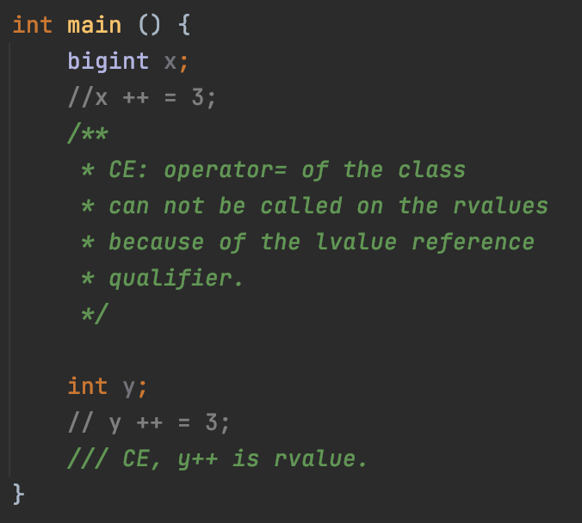
An unexpected recollection from the past 2…
Pic.48: solution of the trouble with bigint
Pic.49: it works.
Conclusion: almost any class should have reference-qualified (compound) assignment operators.

Slide 61
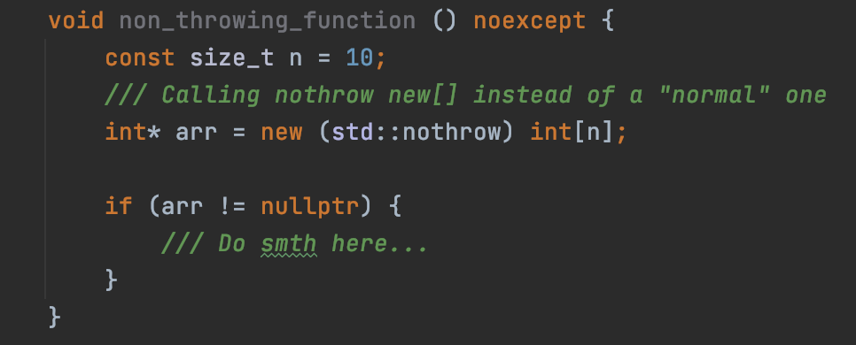


Noexcept specifiers in C++17 (recap)
Noexcept specifier: the noexcept-specification is a part of the function type and may appear as part of any function declaration:
Pic.50: noexcept function example
Pic.51: combining noexcept specifier with qualifiers in methods
Compiler doesn’t prohibit throwing from noexcept function, despite that the whole noexcept-specification mechanism works in compile-time.
Furthermore, if the noexcept function will throw an exception in runtime, the program will be immediately terminated.
Pic.52: throwing from the noexcept

Slide 62


An unexpected recollection from the past 3…
std::move and std::forward are noexcept-specified, so we should support in in our implementations too
Pic.53: std::move implementation, noexcept specification
Pic.54: std::forward implementation, noexcept specification

Slide 63

Conditional noexcept specifiers in C++17
Noexcept specifier can also be conditional.
“Normal” noexcept specification is equivalent to noexcept(true).
In the demonstration, noexcept function throws an exception from itself, but it doesn’t cause the program to be terminated.
The conditional noexcept is a great way to indicate when your function will not throw an exception.
If you make a mistake, it may cause the program to be immediately terminated.
Pic.55: conditional noexcept demo

Slide 64
Potentially throwing functions in C++17
Definition: potentially-throwing functions are:
Functions declared with conditional noexcept specifier whose expression evaluates to false
Functions declared without noexcept specifier except for
Destructors unless the destructor of any potentially-constructed base or member is potentially-throwing.
Default constructor, copy constructors, move constructors that are implicitly-declared or defaulted on their first declaration unless the invocation of any assignment operator in the implicit definition is potentially-throwing.
Copy assignment operators, move assignment operators that are implicitly-declared or defaulted on their first declaration unless the invocation of any assignment operator in the implicit definition is potentially-throwing.
Deallocation functions.
4 more…
Definition: non-throwing functions are all others.

Slide 65

Noexcept operator in C++17
The noexcept keyword can mean 2 things in C++: noexcept specifier (in the standard form or in the conditional form) and operator noexcept.
The noexcept operator performs a compile-time check that returns true if an expression is declared to not throw any exceptions.
It can be used within a function template’s noexcept specifier to declare that the function will throw exceptions for some types (and won’t for all others)
Pic.56: operator noexcept demo

Slide 66

Some useful type traits
std::is_constructible<T, Args…>
If T is an object or reference type and the expression T obj(args...) is well-formed, provides the member constant value equal to true. In all other cases, value is false. i.e, just checks if there is a constructor of the type T that takes arguments of the provided type.
For the purposes of this check, the variable definition is never interpreted as a function declaration.
Access checks are performed as if from a context unrelated to T and any of the types in Args.
Pic.57: example of the usage

Slide 67
Some useful type traits
std::is_default_constructible<T>
Same as std::is_constructible<T> (no Args provided).
std::is_copy_constructible<T>
Same as std::is_constructible<T, const T&>::value
std::is_move_constructible<T>
Same as std::is_constructible <T, T&&>::value

Slide 68

Some useful type traits
std::is_assignable<T, U>
Suppose that t_obj and u_obj are instances of the types T and U respectively. If the expression t_obj = u_obj is well-formed in unevaluated context, provides the member constant value equal to true. Otherwise, value is false.
Access checks are performed as if from a context unrelated to either type.
T and U shall each be a complete type, (possibly const-qualified) void, or an array of unknown bound. Otherwise, the behaviour is undefined.
Pic.58: example of the usage

Slide 69
Some useful type traits
std::is_copy_assignable<T>
Same as std::is_assignable<T, const T&>
std::is_move_assignable <T>
Same as std::is_assignable<T, T&&>

Slide 70

Some useful type traits
std::is_destructible<T>
If T is a reference type, provides the member constant value equal to true.
If T is (possibly const-qualified) void, a function type, or an array of unknown bound, value equals false.
If T is an object type and t_obj is and instance of T, if the expression t_obj.~T() is well-formed in unevaluated context, value equals true. Otherwise, value equals false.
Pic.59: example of the usage

Slide 71

Some useful type traits
std::is_nothrow_constructible<T, Args…>
std::is_nothrow_default_constructible<T>
std::is_nothrow_copy_constructible<T>
std::is_nothrow_move_constructible<T>
std::is_nothrow_assignable<T, U>
std::is_nothrow_copy_assignable<T>
std::is_nothrow_move_assignable<T>
std::is_nothrow_destructible<T>
Same as non-nothrow versions, but noexcept specification is required.
Pic.60: example of the usage

Slide 72

Some useful type traits
std::is_constructible_v<T, Args…>
std::is_nothrow_constructible_v<T, Args…>
std::is_default_constructible_v<T>
std::is_nothrow_default_constructible_v<T>
std::is_copy_constructible_v<T>
std::is_nothrow_copy_constructible_v<T>
std::is_move_constructible_v<T>
std::is_nothrow_move_constructible_v<T>
std::is_assignable_v<T, U>
std::is_nothrow_assignable_v<T, U>
std::is_copy_assignable_v<T>
std::is_nothrow_copy_assignable_v<T>
std::is_move_assignable_v<T>
std::is_nothrow_move_assignable_v<T>
std::is_destructible_v<T>
std::is_nothrow_destructible_v<T>
Since C ++17, there are useful definitions in the standard library that you can use to avoid writing ::value all the time.
Pic.61: example of the usage (excerps from the smart_ptr h/w tests)

